Slide 1

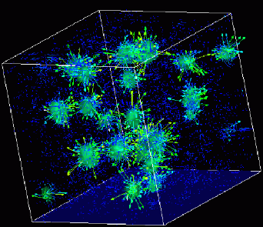

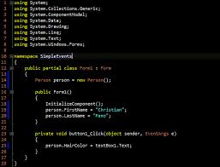
Advanced
Scientific Computing
(SciComp 201)
Session 23
Contour Interpolation

Slide 2
Session Goals
Understand methods for interpolating multi-dimensional data taken from random sample locations
Analyze the mathematics of the Inverse Distance Weighting (IDW) method
Convert non-uniformly measured spatial data to a regular conforming mesh
Develop approaches for estimating “goodness of fit” for predicted interpolated data points
Write code to calculate the Root Mean Square Deviation (RMSD) statistic as a measure of model accuracy

Slide 3
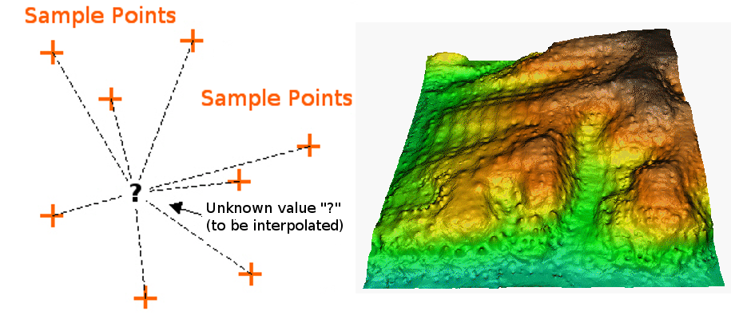
Interpolating Spatial Data

Slide 4
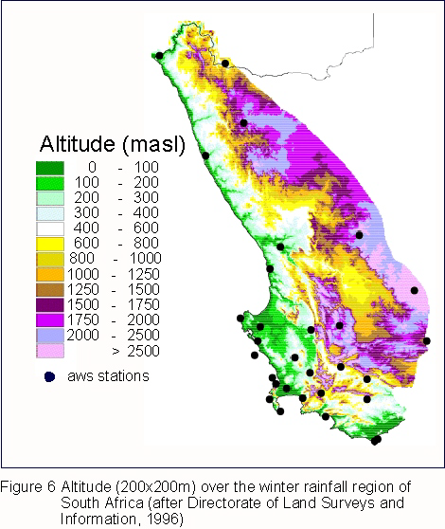
Interpolating Spatial Data

Slide 5
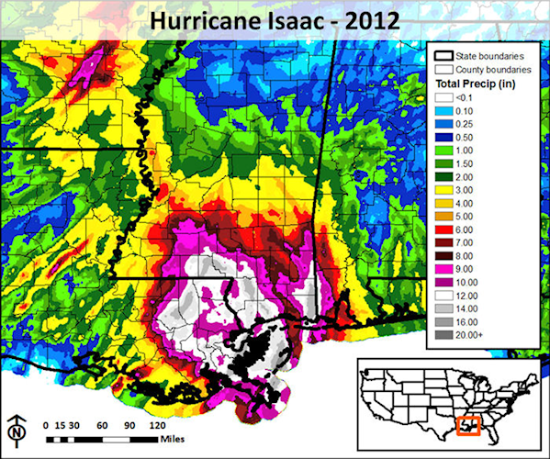
Interpolating Spatial Data

Slide 6
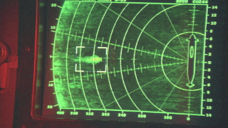
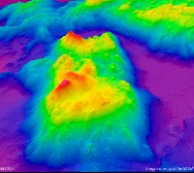


Interpolating Spatial Data
Jonsey Reports

Slide 7
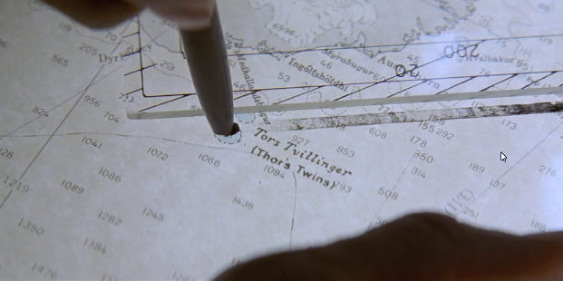
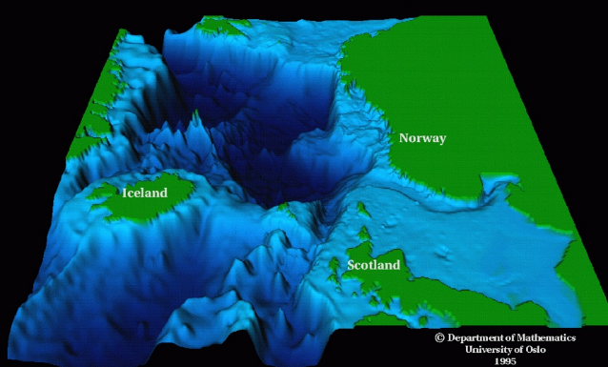
Interpolating Spatial Data
Modi (Brave) and Magni (Strong)

Slide 8
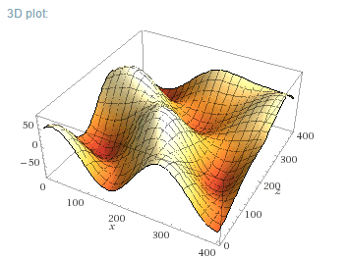
A Fake Ocean “Floor”
$$y=30\sin\left(\frac{x}{4}\right)\cos\left(\frac{z}{4}\right)+50\cos\left(\frac{\sqrt{x^{2}+z^{2}}}{4}\right)⁡$$

Slide 9
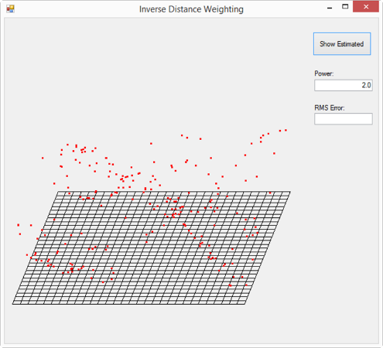
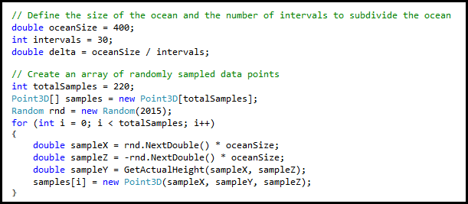
Lab 1 - Inverse Distance Weighting
Ocean area is 400 units square, partitioned into grid of 30 x 30 intervals
Depth samples were taken from 220 random locations
Floor reference grid has height y = -80
Oblique projection
PRNG seed was 2015

Slide 10
The Inverse Distance Weighting (IDW) Method
IDW is a type of deterministic method for multivariate interpolation of a set of scattered points
The value assigned to unknown points are calculated from a weighted average of the values at the known points
The theory is that the farther away a known point is from the unknown point, the less that distant known point can contribute to the unknown height
Closer known points contribute more to the unknown height than known points farther away
Your contribution is inverse to your distance

Slide 11
The Inverse Distance Weighting (IDW) Method
75
X
25
5
10
2
10
2
1
3
$\left(\frac{17.5}{0.8}\right)$→

Slide 12
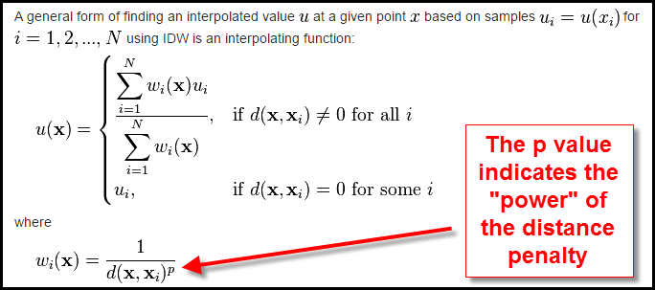
The Inverse Distance Weighting (IDW) Method

Slide 13
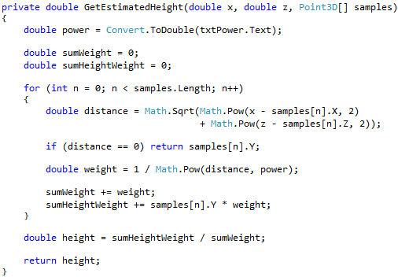
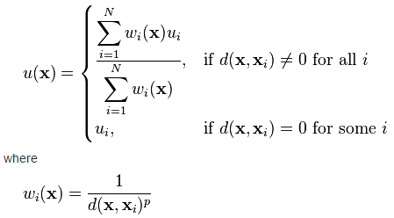
The Inverse Distance Weighting (IDW) Method

Slide 14
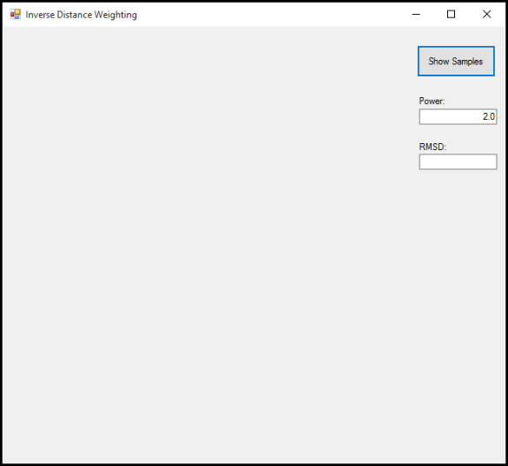
Inverse Distance Weighting
Run Lab 1

Slide 15
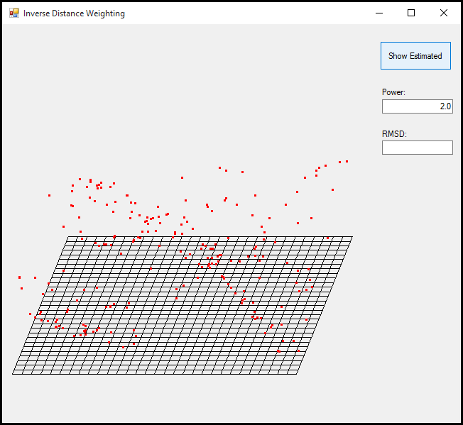
Ocean Depth Samples

Slide 16
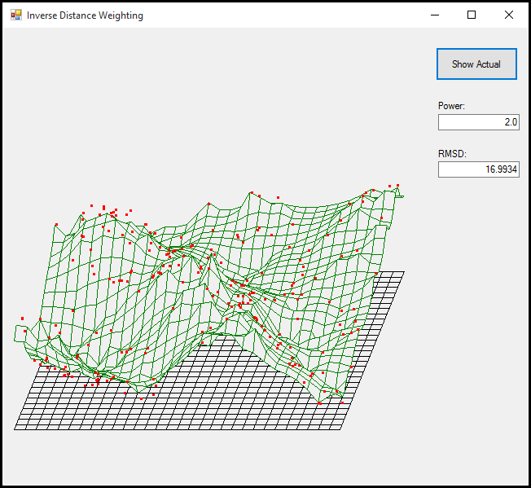
Estimated Ocean Floor

Slide 17
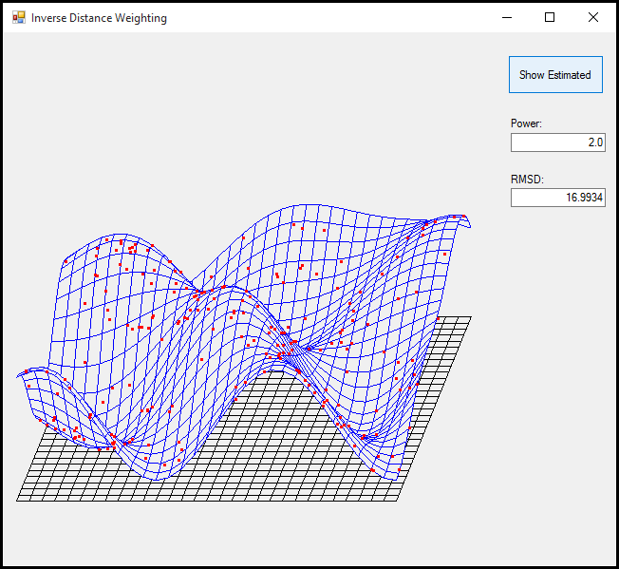
“Actual” Ocean Floor

Slide 18
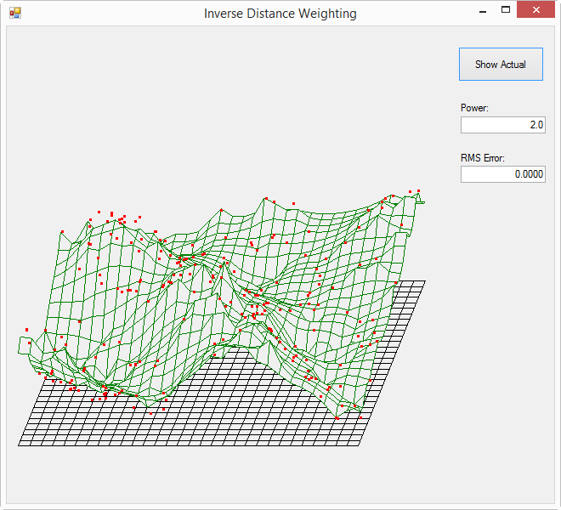
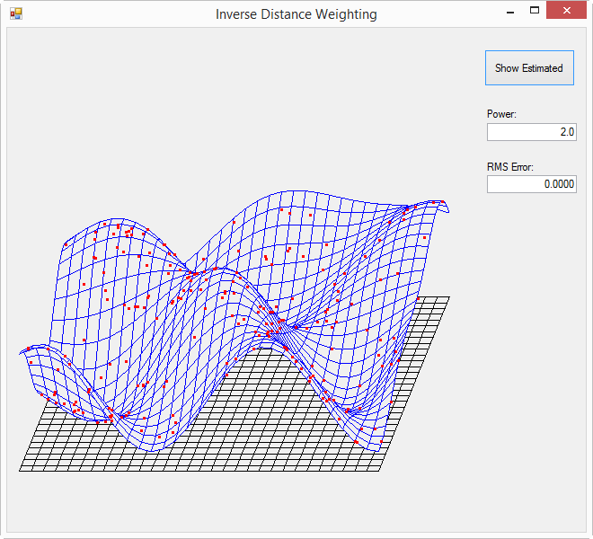
Estimate vs Actual (p = 2.0)
A first order approximation having only 24%
of the world sampled (220 of 900 actual points)

Slide 19
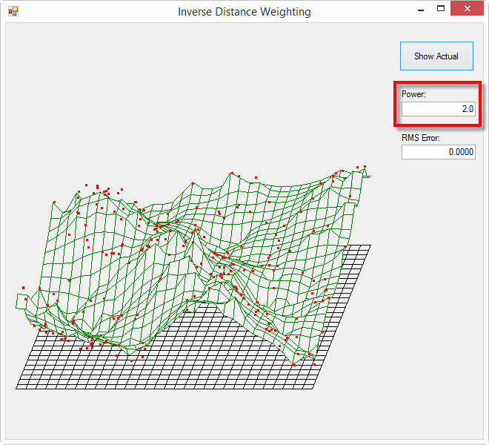
Estimate (p = 2.0)

Slide 20
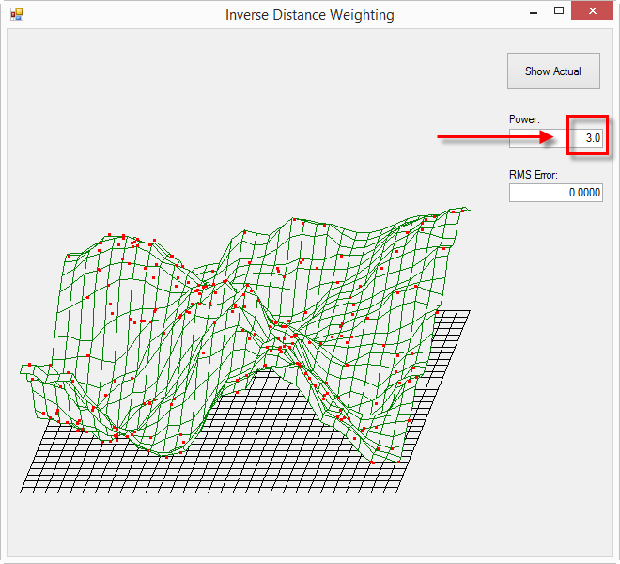
Estimate (p = 3.0)

Slide 21
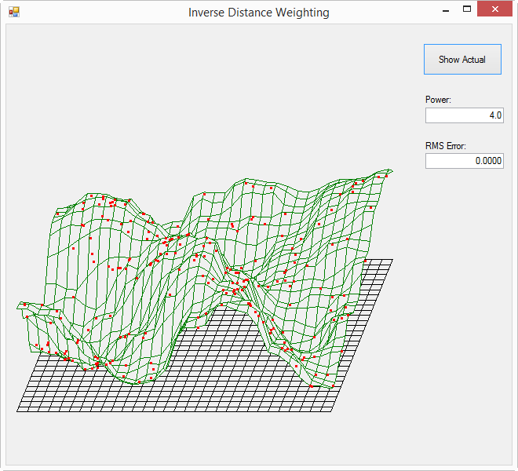
Estimate (p = 4.0)

Slide 22
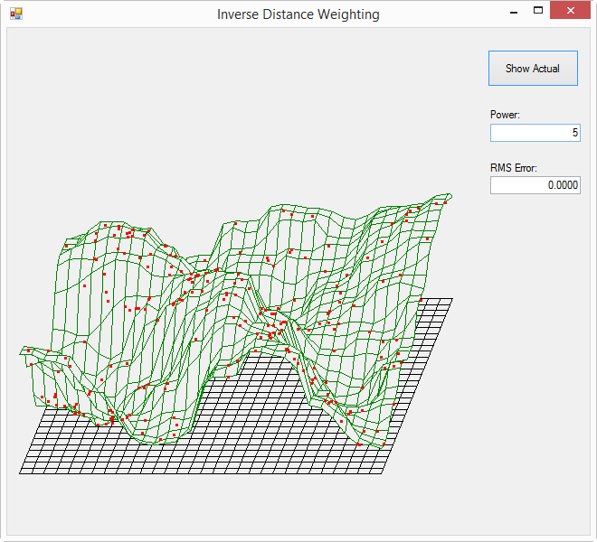
Estimate (p = 5.0)

Slide 23
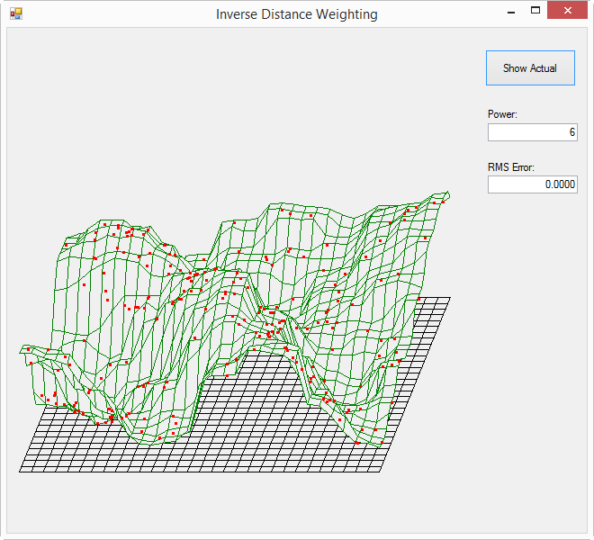
Estimate (p = 6.0)

Slide 24
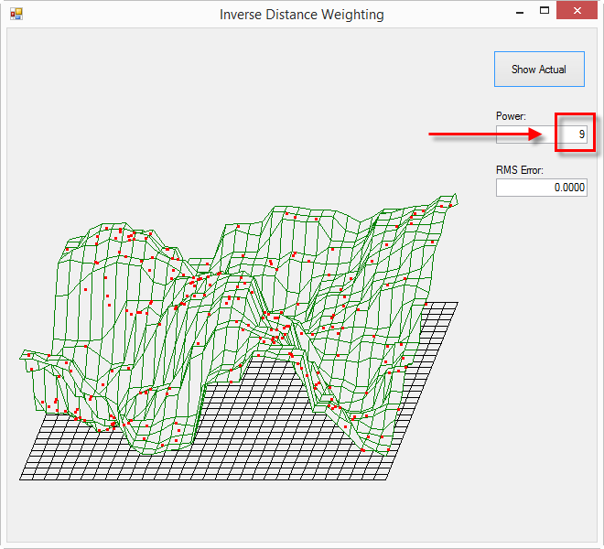
Estimate (p = 9.0)

Slide 25

Root Mean Square Deviation
As we increase the power term p, is our model getting better or worse at predicting reality?
The root-mean-square deviation (RMSD) is a statistic to measure the differences between values predicted by a model and the values actually observed
If we sum ${(actual−estimated)}^{2}$ across all sample points, we can calculate a comparative statistic to empirically determine the optimal p value that minimizes the overall error of the model

Slide 26
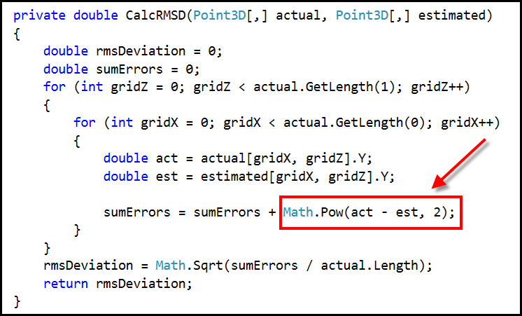
Calculate the RMSD
What value of p minimizes the RMSD?

Slide 27
Estimated Ocean Floor

Slide 28
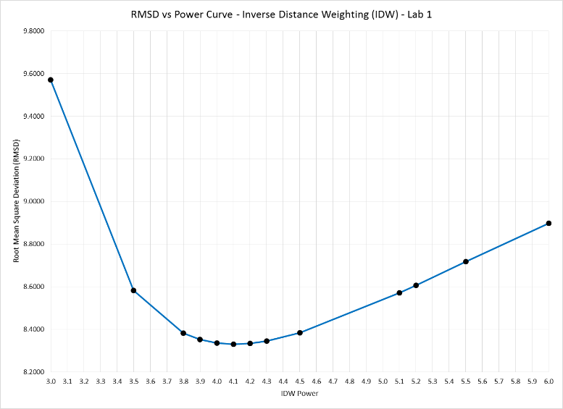
Graphing the RMSD
p = 4.1
minimizes the RMSD for this data set

Slide 29
Additional Research Questions
What happens to the “fit” of the model if p is too high? Why does this occur?
Do you think the estimates are better or worse near the edges of the mesh?
What is the more effective strategy to minimize RMSD?
Spread out and take samples from all over the mesh as equidistant as possible
Take more samples where the measured depth varies sharply between close points

Slide 30
Now you know…
The Inverse Distance Weighting (IDW) method can interpolate multi-dimensional data taken from random sample locations
How to convert non-uniformly measured spatial data into a regular conforming mesh
How to use RMSD as one metric to characterize the “goodness of fit” for predicted interpolated data points
Just like Red October – scientists rarely enjoy the luxury of having too many data samples – we must often interpolate to fill in the missing gaps

